Slide 1
Mastering NT Greek
15. First Aorist Verbs
Here a sa,
there a sa,
everywhere a sa, sa
By Ted Hildebrandt © 2003
Baker Academic

Slide 2
2-1-2 Paradigms - Chant this
2 1 2
λόγος γραφή ἱερόν
λόγου γραφῆς ἱεροῦ
λόγῳ γραφῇ ἱερῷ
λόγον γραφήν ἱερόν
λόγοι γραφαί ἱερά
λόγων γραφῶν ἱερῶν
λόγοις γραφαῖς ἱεροῖς
λόγους γραφάς ἱερά

Slide 3
3rd Declension Chantables
χαρίς ὄνομα, πίστις
χάρις ὄνομα πίστις
χάριτος ὀνόματος πίστεως
χάριτι ὀνόματι πίστει
χάριτα ὄνομα πίστιν
χάριτες ὀνόματα πίστεις
χαρίτων ὀνομάτων πίστεων
χάρισι(ν) ὀνόμασι(ν) πίστεσι(ν)
χάριτας ὀνόματα πίστεις

Slide 4
PAI Verb Chant
λύω λύομεν
λύεις λύετε
λύει λύουσι(ν)

Slide 5
The "is" verb PAI -- εἰμί
εἰμί ἐσμέν εἶ ἐστέ ἐστί(ν) εἰσί(ν)

Slide 6
Imperfect εἰμί
ἤμην ἦμεν ἦς ἦτε ἦν ἦσαν

Slide 7
Person Personal Pronoun Chant
Singular Plural
Nom. ἐγώ σύ ἡμεῖς
Gen. μου σου ἡμῶν Dat. μοι σοι ἡμῖν Acc. με σε ἡμάς
αὐτός, αὐτη, αὐτό (he, she, it)

Slide 8
Present Middle/Passive Indicative
λύομαι, -ομεθα -ῃ, -εσθε -εται, -ονται
I am loosed/am being loosed
I loose myself/am loosing [for myself]

Slide 9
Shape of the Future in Greek
λύσω λύσομεν I will loose We will loose
λύσεις λύσετε You will loose You all will loose
λύσει λύσουσι(ν) S/he/it will loose They will loose
Chant this one

Slide 10
Future Middle Paradigm
λύσομαι -όμεθα -ῃ -εσθε -εται -ονται
I will loose (for myself) We will loose (for ourselves) …

Slide 11
Demonstrative and Relative Pronouns Summary
ἐκεῖνος, ἐκείνη, ἐκεῖνο = that
οὗτος, αὕτη, τοῦτο τούτου, ταύτης, τούτου = this
ὅς ἥ ὅ = Relative (who, which) οὗ ἧς οὗ

Slide 12
Imperfect Active Paradigm of λύω
Chant: ἐλυον, ν, ς, ε, μεν, τε, ν I was loosing, …

Slide 13
Imperfect Middle/Passive (IM/PI)
Chant: ἐλυόμην ου, ετο, ομεθα, εσθε, οντο
I was being loosed

Slide 14
Person Personal Pronoun Chant
Singular Plural
Nom. ἐγώ σύ ἡμεῖς
Gen. μου σου ἡμῶν Dat. μοι σοι ἡμῖν Acc. με σε ἡμάς
αὐτός, αὐτή, αὐτό (he, she, it)

Slide 15
Second Aorist Active Chant
ἔλαβον ν, σ, ε, μεν, τε, ν

Slide 16
Second Aorist Middle Chant
ἐγενόμην -ου, -ετο, -ομεθα, -εσθε, -οντο

Slide 17
Aorist Stem Changes -- 8 to know
ἔρχομαι == ἦλθον (I came, went)
βλέπω == εἶδον (I saw)
λέγω == εἶπον (I said)
γίνομαι == ἐγενόμην (I became)
γινώσκω == ἔγνων (I knew)
ἔχω == ἔσχον ( I had)
λαμβάνω == ἔλαβον (I took)
εὑρίσκω == εὗρον (I found)

Slide 18
Rapping the Lord’s Prayer
Πάτερ ἡμῶν ὁ ἐν τοῖς οὐρανοῖς father our the one in heaven
ἁγιασθήτω τὸ ὄνομά σου make holy name your
ἐλθέτω ἡ βασιλεία σου let come kingdom your
γενηθήτω τὸ θέλημά σου, let be will your

Slide 19
Rapping the Lord’s Prayer
ὡς ἐν οὐρανῷ καὶ ἐπὶ γῆς· as in heaven also on earth
τὸν ἄρτον ἥμῶν τὸν the bread our
ἐπιούσιον δὸς ἡμῖν σήμερον· daily give us today

Slide 20
Introduction to First Aorists: English
Two ways of forming the past in English
1) Suffixed -ed -- 1st Aorist (σα)
Charlie laughs.
Charlie laughed.
2) Internal Stem change -- 2nd Aorist
Charlie runs.
Charlie ran.

Slide 21
Basic 1st Aorist form
Augment+Verb Stem+Tense Formative+Secondary End
ε + λυ + σα + ς = ἔλυσας

Slide 22
1st Aorist Active Paradigm
Singular Plural
ἔλυσα ἐλύσαμεν I loosed we loosed
ἔλυσας ἐλύσατε you loosed you all loosed
ἔλυσε(ν) ἔλυσαν He/she/it loosed they loosed
Chant: ἔλυσα: --, ς, ε, μεν, τε, ν

Slide 23
1st Aorist Middle Paradigm
Singular Plural
ἐλυσάμην ἐλυσάμεθα I loosed for myself we loosed for ourselves
ἐλύσω ἐλύσασθε you loosed for yourself you all loosed for yourselves
ἐλύσατο ἐλύσαντο s/he/it loosed for himself they loosed for themselves
Chant: ἐλυσάμην: -ω, -ατο, -αμεθα, -ασθε, -αντο

Slide 24
Ending transformations
Velars: κ, γ, or χ + σ = ξ
ἐδίδαξα
Labials: π, β, or φ + σ = ψ
ἔβλεψα
Dentals: τ, δ, or θ + σ = σ
ἔπεισα (from πείθω) (I persuaded)
Lemoners ( λ, μ, ν, or ρ) + σ = ___
Sigma dropped and vowel lengthened: ἔμεινα

Slide 25
First Aorist Verbs List:
ἀκούω -- ἤκουσα (I heard)
ἀποστέλλω -- ἀπέστειλα (I sent)
βλέπω -- ἔβλεψα (I saw)
γράφω -- ἔγραψα (I wrote)
διδάσκω -- ἐδίδαξα (I taught)
πιστεύω -- ἐπίστευσα (I believed)
θέλω -- ἠθέηλσα (I wished)

Slide 26
First Aorist Verbs List (cont.)
μένω -- ἔμεινα (I remained)
κρίνω -- ἔκρινα (I judged)
σῴζω -- ἔσωσα (I saved)

Slide 27
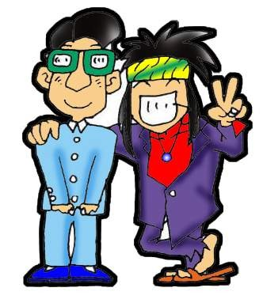
Chapter 15 Vocabulary
ἄλλος, -η, -ο
other

Slide 28
Chapter 15 Vocabulary
ἄρτος, -ου, ὁ
bread

Slide 29
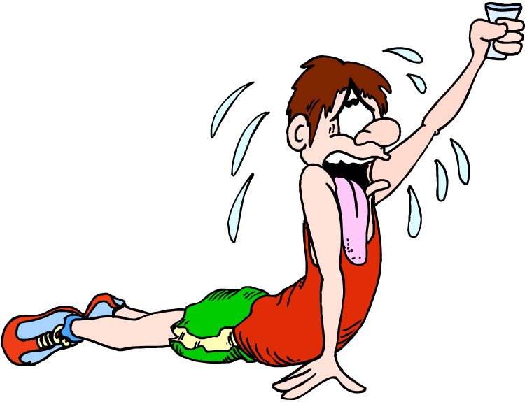
Chapter 15 Vocabulary
δεῖ
it is necessary

Slide 30
Chapter 15 Vocabulary
ἐξουσία, -ας, ἡ
authority

Slide 31
Chapter 15 Vocabulary
ἕτερος, -α, -ον
different

Slide 32
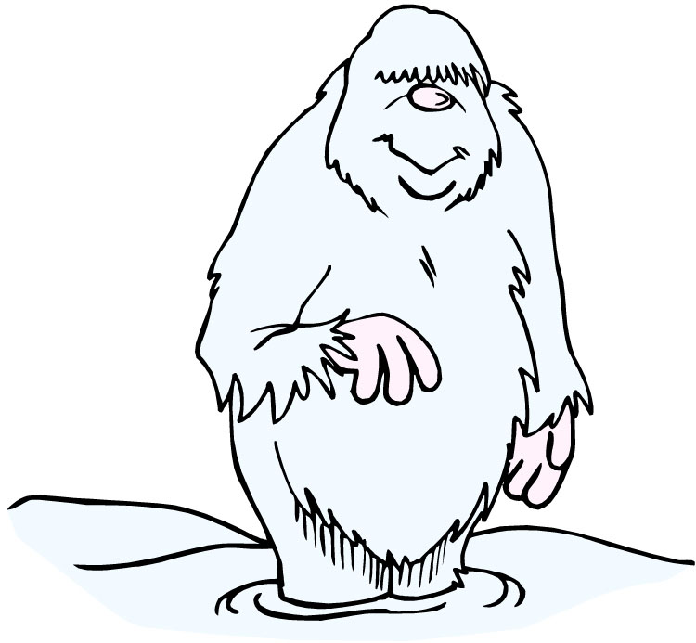
Chapter 15 Vocabulary
ἔτι
yet, still

Slide 33
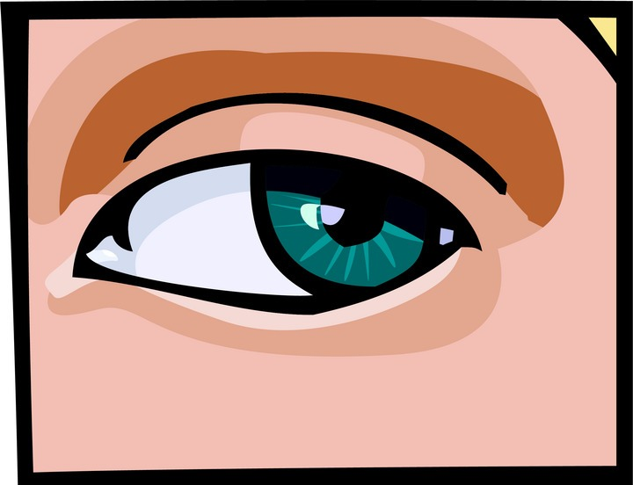
Chapter 15 Vocabulary
ὀφθαλμός, -οῦ, ὁ
eye

Slide 34
Chapter 15 Vocabulary
τέκνον, -ου, τό
child

Slide 35
Chapter 15 Vocabulary
τόπος, -ου, ὁ
place

Slide 36
Chapter 15 Vocabulary
φῶς, φωτός, τό
light

Slide 37
Quick Vocabulary Review

Slide 38
Ch. 1 -- Vocabulary
angel, messenger
ἄγγελος, -ου, ὁ
verily, truly
ἀμήν
man, humankind
ἄνθρωπος, -ου, ὁ
I
ἐγώ
God
θεός, -οῦ, ὁ

Slide 39
Ch. 1 -- Vocabulary
and, also, even
καί
heart
καρδία, -ας, ἡ
I say
λέγω
prophet
προφήτης, -ου, ὁ
Christ, Messiah
Χριστός, -οῦ, ὁ

Slide 40
Ch. 2 -- Vocabulary
brother
ἀδελφός, -οῦ, ὁ
I hear, obey
ἀκούω
glory, fame
δόξα, -ης, ἡ
I have
ἔχω
world
κόσμος, -ου, ὁ

Slide 41
Ch. 2 -- Vocabulary
Lord, sir
κύριος, -ου, ὁ
word
λόγος, -ου, ὁ
Peter
Πἑτρος, -ου, ὁ
son
υἱός, -οῦ, ὁ
Pharisee
Φαρισαῖος, -ου, ὁ

Slide 42
Ch. 3 -- Vocabulary
but, yet
ἀλλἀ
apostle, sent one
ἀπόστολος, -ου, ὁ
I see
βλέπω
for, then
γάρ
I know
γινώσκω

Slide 43
Ch. 3 -- Vocabulary
Jesus
Ἰησοῦς, -οῦ, ὁ
I take, receive
λαμβάνω
I loose
λύω
heaven
οὐρανός, -οῦ, ὁ
I believe
πιστεύω

Slide 44
Ch. 4 -- Vocabulary
I love
ἀγαπάω
I write
γράφω
but, and
δέ
servant, slave
δοῦλος, -ου, ὁ
I find
εὑρίσκω

Slide 45
Ch. 4 -- Vocabulary
temple
ἱερόν, -οῦ, τό
People
λαός, -οῦ, ὁ
law
νόμος, -ου, ὁ
house
οἶκος, -ου, ὁ
as, about, how
ὡς

Slide 46
Ch. 5 -- Vocabulary
love
ἀγάπη, -ης, ἡ
truth
ἀλήθεια, -ας, ἡ
sin
ἁμαρτία, -ας, ἡ
kingdom
βασιλεία, -ας, ἡ
writing, Scripture
γραφή, -ῆς, ἡ

Slide 47
Ch. 5 -- Vocabulary
I raise up
ἐγείρω
assembly, church
ἐκκλησία, -ας, ἡ
work
ἔργον, -ου, τό
disciple
μαθητής, -οῦ, ὁ
Hour
ὥρα, -ας, ἡ

Slide 48
Chapter 6 Vocabulary
ἀπό (Gen.)
from
διά (Gen.)
through
διά (Acc.)
on account of
εἰς (Acc.)
into

Slide 49
Chapter 6 Vocabulary
ἐκ (Gen.)
out of, from
ἐν (Dat.)
in
ἐπί (Gen.)
on, over
ἐπί (Dat.)
on, at, against, on the basis of

Slide 50
Chapter 6 Vocabulary
ἐπί (Acc.)
on, to, toward, against
κατά (Gen.)
down, against
κατά (Acc.)
according to
μετά (Gen.)
with

Slide 51
Chapter 6 Vocabulary
μετά (Acc.)
after, behind
περί (Gen.)
about, concerning
περί (Acc.)
around, near
πρός (Acc.)
to

Slide 52
Vocabulary -- Ch. 7
good
ἀγαθός, -ή, -όν
Holy
ἅγιος, -α, -ον
righteous
δίκαιοις, -α, -ον

Slide 53
Vocabulary – Ch. 7
I am
εἰμί
Jewish, a Jew
Ἰουδαῖος, -α, -ον
Great
μέγας, μεγάλη, μέγα

Slide 54
Vocabulary -- Ch. 7
dead
νεκρός, -ά, -όν
no, not
οὐ, οὐκ, οὐχ
first
πρῶτος, -η, -ον
voice
φωνή, -ῆς, ἡ

Slide 55
Vocabulary Ch. 8
he/she/it
αὐτός, -ή, -ό
land, earth, region
γῆ, -ῆς, ἡ
I, we
ἐγώ, ἡμεῖς
day
ἡμέρα, -ας, ἡ
that, so that
ὅτι

Slide 56
Vocabulary Ch. 8
so, then, therefore
οὖν
crowd
ὄχλος, -ου, ὁ
from
παρά (with Gen.)
beside, with
παρά (with Dat.)
alongside, beside
παρά (with Acc.)

Slide 57
Vocabulary Ch. 8
you / you (pl)
σύ / ὑμεῖς
by, at the hands of
ὑπό (with Gen.)
under, below
ὑπό (with Acc.)

Slide 58
Vocabulary Ch. 9
I answer
ἀποκρίνομαι
I send
ἀποστέλλω
I throw
βάλλω
I become
γίνομαι
I come in
εἰσέρχομαι

Slide 59
Vocabulary Ch. 9
I go out
ἐξέρχομαι
I come/go
ἔρχομαι
I wish
θέλω
thus, so
οὕτως
I go
πορεύομαι

Slide 60
Vocabulary Ch. 10
life
ζωή, -ῆς, ἡ
death
θάνατος, -ου, ὁ
I judge
κρίνω
I remain
μένω
only, alone
μόνος, -η, -ον

Slide 61
Vocabulary Ch. 10
now
νῦν
and not, nor
οὐδέ
Paul
Παῦλος
I save
σῴζω
then
τότε

Slide 62
Chapter 11 Vocabulary
ἀπέρχομαι
I go away, leave
ἐκεῖνος
that
Ἰουδαῖος, -α, -ον
Jewish
καθώς
as, just as

Slide 63
Chapter 11 Vocabulary
ὅς, ἥ, ὅ
who, which
ὅταν
when
πάλιν
again
οὗτος, αὗτη, τοῦτο
this

Slide 64
Chapter 11 Vocabulary
Πέτρος, -ου, ὁ
Peter
ὑπέρ
for, about (gen.)
above, beyond (acc.)

Slide 65
Chapter 11 Vocabulary
ὑπέρ
for, about (gen.)
above, beyond (acc.)

Slide 66
Chapter 12 Vocabulary
ἀποθνῄσκω
I die
ἐκεῖ
there
ἕως
until
ἰδού
behold

Slide 67
Chapter 12 Vocabulary
ἵνα
in order that, that
Ἰωάννης, -ου, ὁ
John
μέν
on the one hand, indeed
ὅλος, -η, -ον
whole, entire

Slide 68
Chapter 12 Vocabulary
ὅτε
when
σύν
with

Slide 69
Chapter 13 Vocabulary
ἀνήρ, ἀνδρός, ὁ
man, husband
βασιλεύς, -ἐως, ὁ
king
δύναμις, -εως, ἡ
power, miracle
ὄνομα, -ματος, τό
name
πᾶς, πᾶσα, πᾶν
each, every, all

Slide 70
Chapter 13 Vocabulary
πατήρ, πατρός, ὁ
father
πιστις, πίστεως, ἡ
faith, belief
πνεῦμα, -ατος, τό
spirit, wind
σάρξ, σαρκός, ἡ
flesh, body
χάρις, -ιτος, ἡ
grace, kindness

Slide 71
Chapter 14 Vocabulary
αἷμα, -ματος, τό
blood
αἴρω
I raise, take up
διδάσκω
I teach
ἴδιος, -α, -ον
one's own
καλός, -ή, -όν
good

Slide 72
Chapter 14 Vocabulary
μέλλω
I am about to, intend
ὁδός, -οῦ, ἡ
way
πολύς, πολλή, πολύ
much, many
σῶμα, -ματος, τό
body
ψυχή, -ῆς, ἡ
soul, life

Slide 73
Chapter 15 Vocabulary
ἄλλος, -η, -ο
other
ἄρτος, -ου, ὁ
bread
δεῖ
it is necessary
ἐξουσία, -ας, ἡ
authority
ἕτερος, -α, -ον
different

Slide 74
Chapter 15 Vocabulary
ἔτι
yet, still
ὀφθαλμός, -οῦ, ὁ
eye
τέκνον, -ου, τό
child
τόπος, -ου, ὁ
place
φῶς, φωτός, τό
light

